Slide 1
Hotel Customer Reviews Text Classification
Group members:
Ajitesh Chauhan
Rishi Dave
Shefali Kolge

Slide 2
Introduction
Datafiniti provides intelligent data for data-driven businesses
It’s business data is used to leverage their large catalog of companies from hundreds of online directories and review websites.
Datafiniti gathers and structures a wide breadth of business information for each business tracked in their catalog.

Slide 3
Objective
We have a hotel reviews business data from Datafiniti.
Our goal here is to analyse only the text of the customer’s reviews and classify them according to its nature i.e. whether it is a good review, a medium review or a bad one.

Slide 4
Design
Data Understanding
Data Preparation
Model Building
Evaluation
Insights

Slide 5
Data Understanding
It is a 35.9k x 19 list of hotels and their reviews provided by Datafiniti's Business Database. The dataset includes hotel location, name, rating, review data, title, username, and more.
We used just the reviews text and reviews rating attributes from the data.

Slide 6
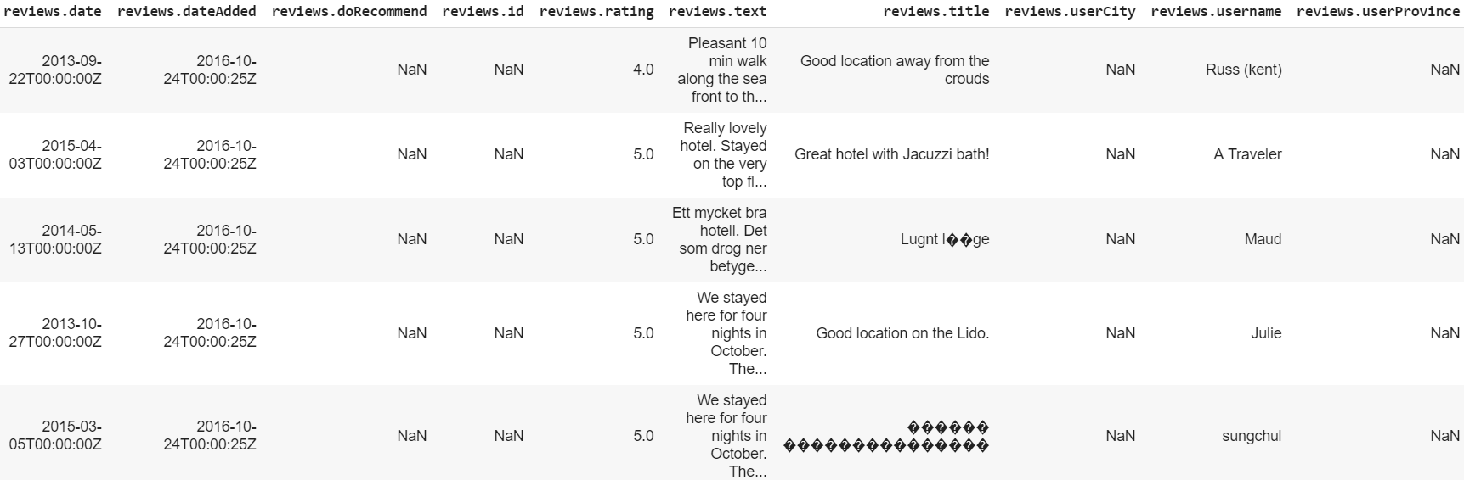
Sample Data
Sample Data

Slide 7
Data Preparation
Filter out ratings that are zero.
A few hundred ratings had a score above 5, so filtered out.
Also, ratings had decimals, rounded them down to an integer.
Filled few reviews text NA values to ‘x’.
Created labels from reviews rating by cutting them to “bad”, “medium” and “good” with pd.cut().

Slide 8
Workflow
Prepared the target variable: review labels with values “bad”, “medium” and “good”.
Lemmatization operation:
Remove all the special characters
single characters
Substituting multiple spaces with single space
Removing prefixed 'b’
Converting to Lowercase
Removed all stopwords.
Feature Extraction:
Vectorization of reviews text
Transformed into TfIdf
Model Building:
MultinomialNB
LinearSVC
Used Over sampling and Under sampling techniques
Model Evaluation

Slide 9
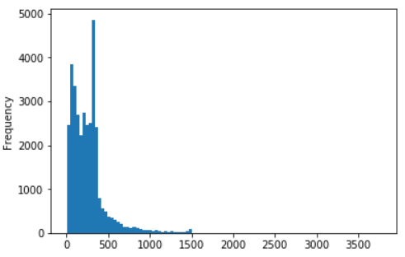
Exploratory Data Analysis
Frequency of length of all reviews text:

Slide 10
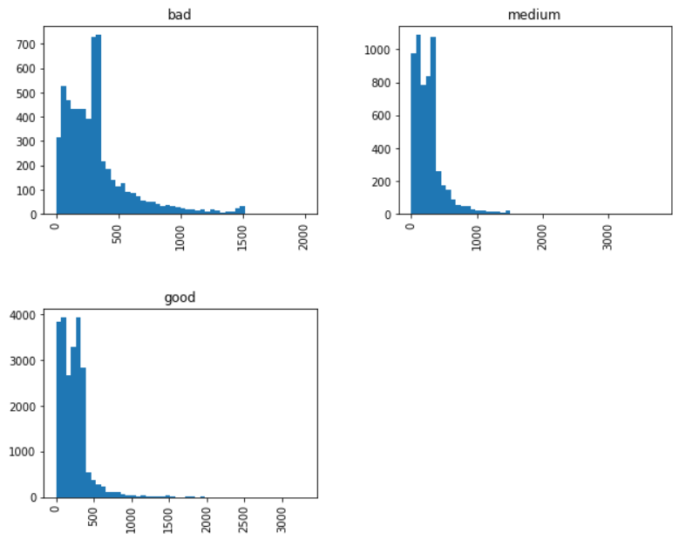
Frequency of length of reviews text according to labels:

Slide 11
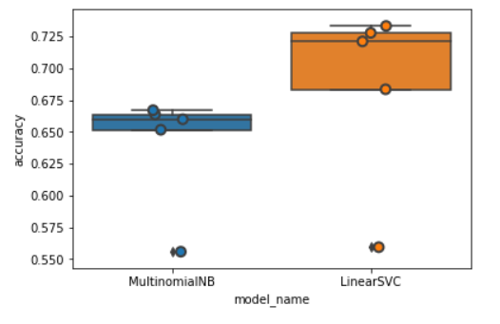
Model VS Accuracy Representation

Slide 12
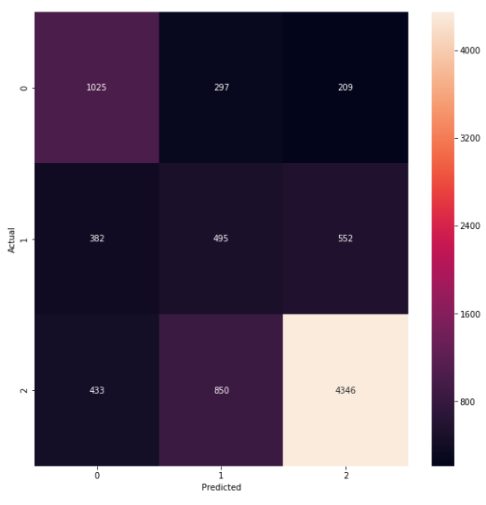
LinearSVC with Over Sampling

Slide 13
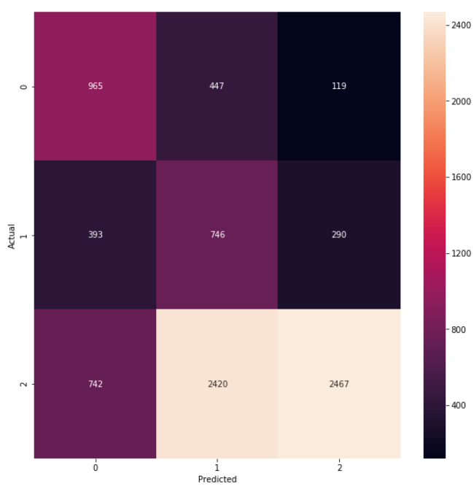
LinearSVC with Over Sampling

Slide 14
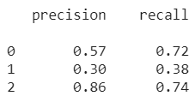
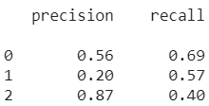
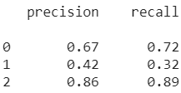
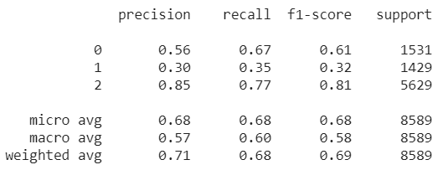
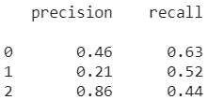
Techniques used and its metrics
Techniques | Train Accuracy | Test Accuracy | Precision and Recall
MultinomialNB with Over Sampling | 72.48% | 68.49%
MultinomialNB with Under Sampling | 81.26% | 49.32%
LinearSVC | 96.18% | 76.81%
LinearSVC with Over Sampling | 83.00% | 68.30%
LinearSVC with Under Sampling | 93.72% | 48.64%

Slide 15
Thank You

